Slide 1
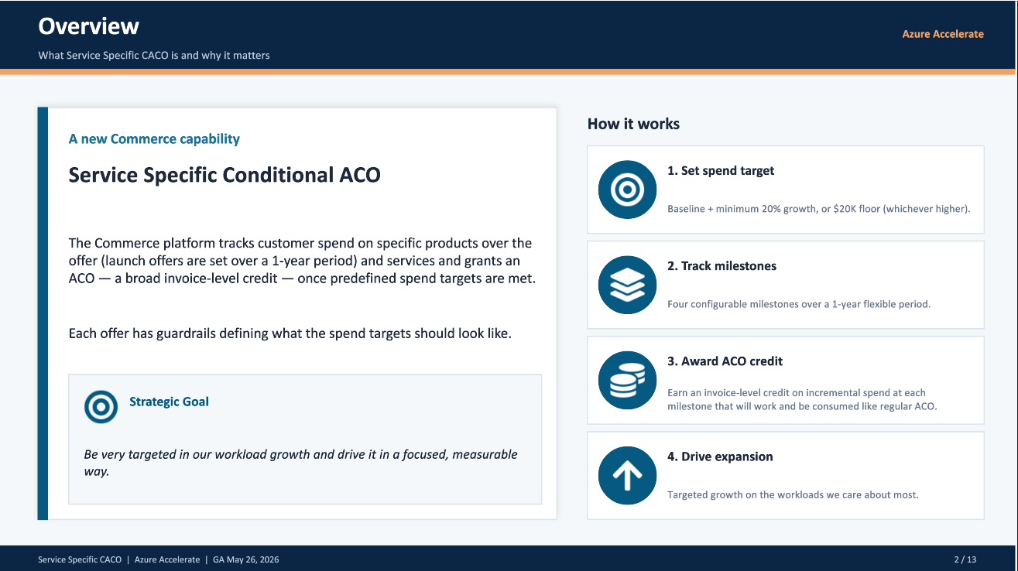
Service Specific Conditional ACO

Slide 2
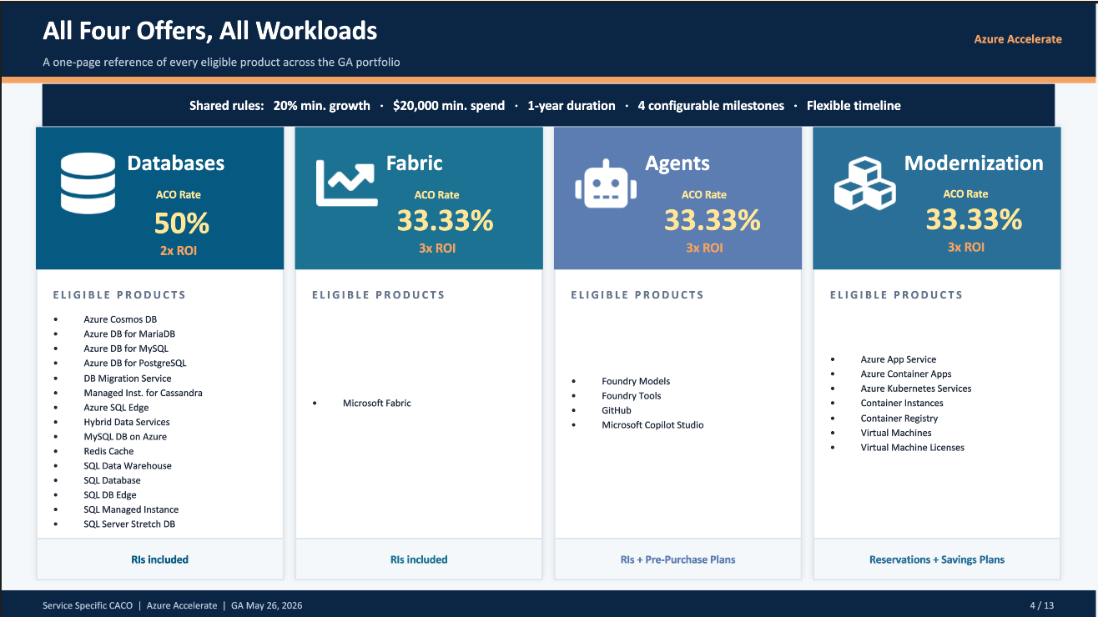
Service Specific Conditional ACO

Slide 3
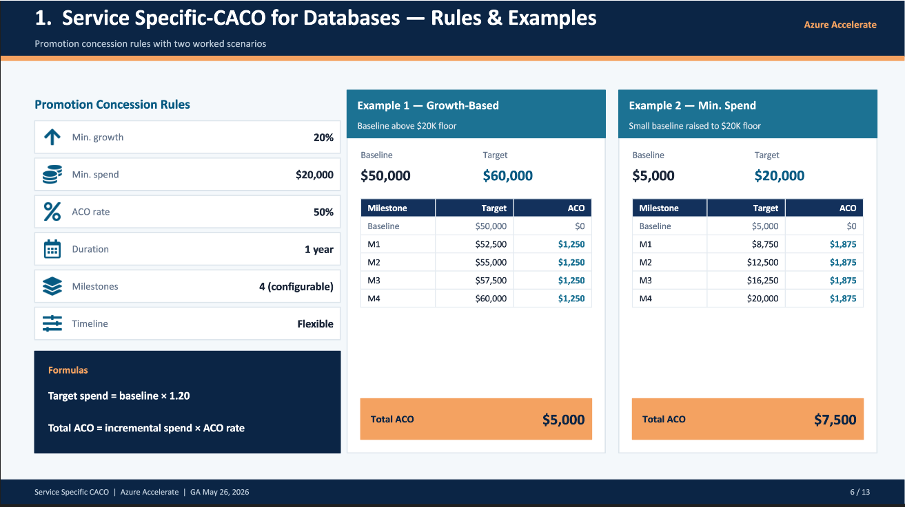
Service Specific Conditional ACO

Slide 4
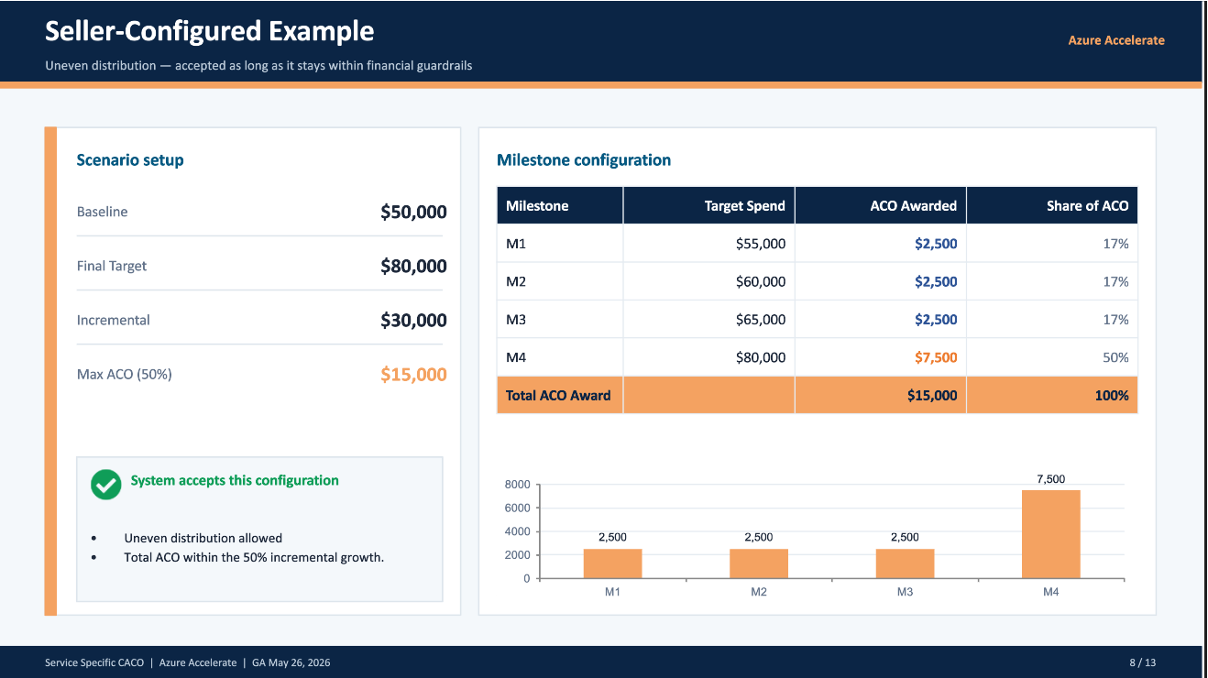
Service Specific Conditional ACO

